Slide 1
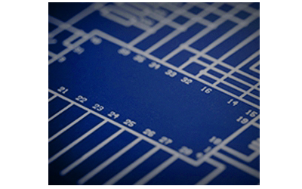

LAB NOTEBOOK
EECT 111-50c
CIRCUIT ANALYSIS
JOSIAH D ABEL
INSTRUCTOR: Lou Toth
Spring 2015

Slide 2
TABLE OF CONTENTS:
LAB #: Title | DATE | SLIDE NUMBERS
Lab 1: Resistor Variability | 1-15-2015 | 3-10
Lab 2: Reading and Sorting Resistors | 1-29-2015 | 11-18
Lab 3: Series Resistors Current and Voltage | 1-29-2015 | 19-25
Lab 4: Black Box Design (Series) | 2-12-2015 | 26-33
Lab 5: Black Box Design (Parallel) | 2-19-2015 | 34-42
Lab 6: N/AFourResistorPara | - | 43-44
Lab 7: Four Resistor Parallel Circuit | 2-26-2015 | 45-52
Lab 8: Black Box 3 Design | 2-26-2015 | 53-60
Lab 9: Series/Parallel Resistors | 3-26-2015 | 61-69
Lab 10: Series/Parallel Capacitors | 4-2-2015 | 70-77
Lab 11: RC Lab | 4-9-2015 | 78-87
Lab 12: Series/Parallel Inductors | 4-23-2015 | 88-95

Slide 3
LAB 1: Resistor Variability
Josiah Abel
Date: 1/15/2015
Lab Partners: Dakota Johnson and Alex Richards
Lab Bench # 1
EECT 111

Slide 4
Lab 1 – Resistor Variability
OBJECTIVE: To demonstrate that not all resistors have the same exact value of resistance.
-MATERIALS-
Digital Multimeter, GW INSTEK GDM-8245, Serial #: CL860259
10, 1KΩ (Kohm) Resistors, (Color Code: Brown, Black, Red, Gold)

Slide 5
Lab 1 – Resistor Variability, Procedure
Ten 1 k ohm resistors, with the color code brown, black, red, gold, were measured in the lab using the digital multimeter set as an ohmmeter. The values were recorded. Data from six other lab groups were combined with the data gathered to create a table of 70 tested resistors in total. The Data was transferred to an Excel Spreadsheet and the data was placed into a graph. The upper and lower tolerance limits were graphed. The smallest and largest resistance measurements were found and the average resistance and standard deviation were calculated.

Slide 6
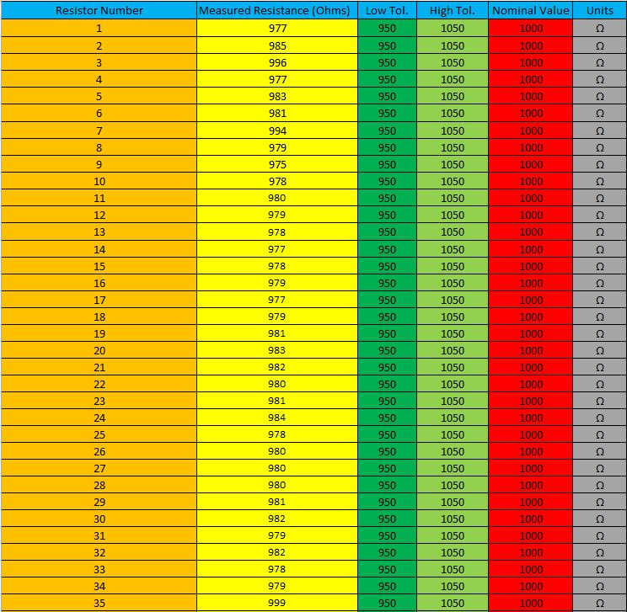
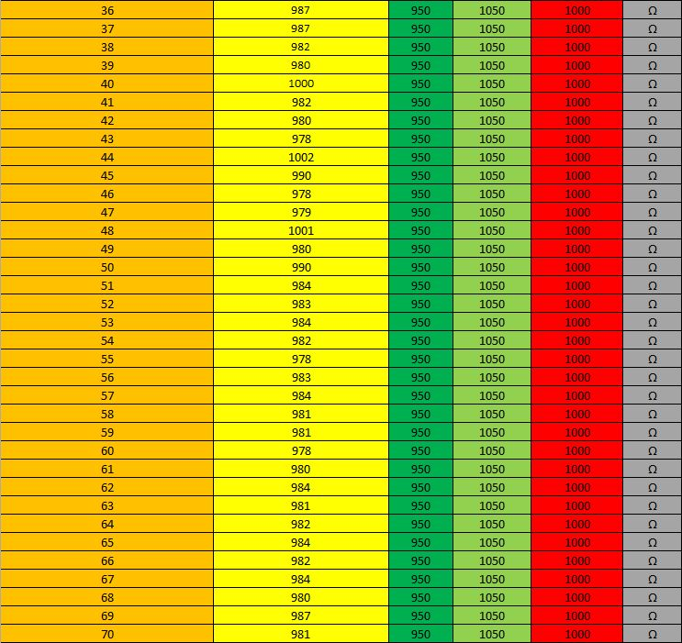
Lab 1 DATA: (the data begins on the left table and continues on the top of the right table)

Slide 7
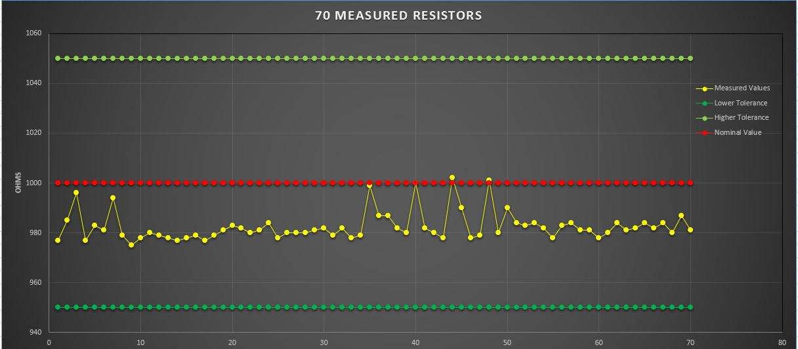
Graph of Resistor Measurements

Slide 8


Lab 1 – Resistor Variability, Calculations
DATA CALCULATIONS:
Resisters Used: | 1000 | Ohms (1k)
Resistor code: | Brown,black,red,gold
Tolerance (Low Tolerance): | 950 | Ω
Tolerance (High Tolerance): | 1050 | Ω
Mean: | 982.6 | Ω
Standard Dev: | 5.82 | Ω
Median: | 981 | Ω
Mode: | 980 | Ω
Smallest: | 975 | Ω
Largest: | 1002 | Ω
Range: | 27 | Ω
$$Arithmatic Mean= \frac{Sum of All Values}{Number of Values}$$
Standard Deviation:

Slide 9
Lab 1 – Resistor Variability, Observations
The Majority of the resistors measured remained in the lower tolerance level.
Only three measurements reached 1,000 ohms or more.
All of the resistors had the same tolerance level of 5%.

Slide 10
Lab 1 – Resistor Variability, Conclusions
By measuring each resistor with the digital multimeter the actual resistance value for the resistor was found. These values differed from the expected value of 1,000 ohms demonstrating that not all resistors are created equal.
Therefore when they are constructed they receive a designated tolerance value that declares what values the resistor will still be useful in. The variance in Resistors must be accounted for in any project because the value of the resistor is not the same as the value of the resistor.

Slide 11
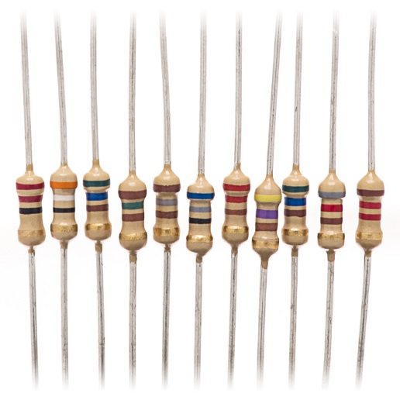
LAB 2: Reading And Sorting Resistors
Josiah Abel
Date: 1/29/2015
Lab Partners: Dakota Johnson and Cody Fletcher
Lab Bench # 6
EECT 111

Slide 12
Lab 2 – Reading and Sorting Resistors
OBJECTIVE: To learn the resistor color code of 15 different resistors from smallest to largest value.
-MATERIALS-
Digital Multimeter, GW INSTEK GDM-8245, Serial #: CL860332
15 unique resistors, (100 Ω, 220 Ω, 330 Ω, 470 Ω, 1 KΩ, 2.2 KΩ, 3.3 KΩ, 4.7 KΩ, 10 KΩ, 22 KΩ, 33 KΩ, 47 KΩ, 100 KΩ, 1 MΩ, and 10 MΩ)

Slide 13
Lab 2 – Reading and Sorting Resistors, Procedure
The fifteen unique resistors had their color code recorded and were measured in the lab using the digital multimeter set as an ohmmeter. The values were recorded. The measured values, expected values and color codes were compared.

Slide 14
Resistor Color Code Table and Measurements

Slide 15
Lab 2 – Reading and Sorting Resistors, Observations
All of the measured resistors had a tolerance rating of 5%. Meaning that the value measured could be within five percent of the nominal resistor value and color code.
The first band of the color code indicates the first value of the resistor. The second band indicates the second value of the resistor. The third band indicates the multiplier of the first two values (10^third band).
Black = 0, Brown = 1, Red = 2, Orange = 3, Yellow = 4, Green = 5, Blue = 6, Violet = 7, Grey = 8 and White = 9.

Slide 16
Lab 2 – Reading and Sorting Resistors
The Resistor Color code values are as follows:
Black = 0,
Brown = 1,
Red = 2,
Orange = 3,
Yellow = 4,
Green = 5,
Blue = 6,
Violet = 7,
Grey = 8
and White = 9.
A Handy Pneumonic device for remembering the order of the Colors is as follows:
Bad (Black)
Booze (Brown)
Rots (Red)
Our (Orange)
Young (Yellow)
Guts (Green)
But (Blue)
Vodka (Violet)
Goes (Grey)
Well (White)

Slide 17

“ That’s A good way to remember it!”

Slide 18
Lab 2 – Reading and Sorting Resistors, Conclusion
The measured resistance values were all within tolerance of the nominal values and the color code that represents that value.

Slide 19
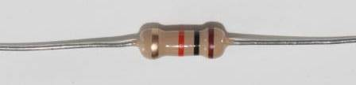
LAB 3:Series Resistors Current and Voltage
Josiah Abel
Date: 1/29/2015
Lab Partners: Dakota Johnson and Cody Fletcher
Lab Bench # 6
EECT 111

Slide 20
Lab 3 – Series Resistors Current and Voltage
OBJECTIVE: To measure the resistance in a series circuit and compare the measurements to the calculated and simulated results.
-MATERIALS-
Digital Multimeter, GW INSTEK GDM-8245, Serial #: CL860332
NI ELVIS II+, breadboard, Serial #: 1677D1E
3 resistors, (2.2 KΩ, 4.7 KΩ, and 10 KΩ)
Multisim 13.0 Computer program

Slide 21
Lab 3 – Series Resistors Current and Voltage, Procedure
The three resistors had their color code recorded and were measured in the lab using the digital multimeter set as an ohmmeter. The values were recorded. They were then placed into a series circuit beginning with the 10Kohm resistor and ending with the 4.7Kohm resistor.
The total resistance of the circuit was measured using the ohmmeter. The same circuit was built in Multisim 13.0 and the total resistance of the circuit was measured and simulated. Using the nominal values of the resistors they were added together to calculate the total resistance of the circuit for a third time. The measured values, calculated values and Simulated values for total resistance (RT) would then be used with total voltage (V1) to calculate or measure the total current and the voltage drops across each resistor.

Slide 22
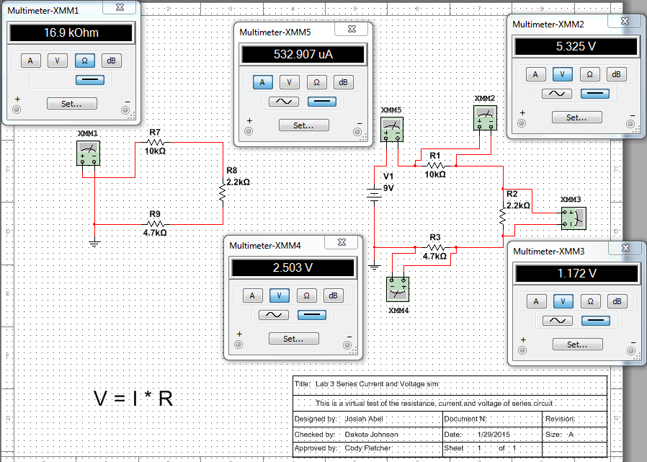
Lab 3 – Series Resistors Current and Voltage
SIMULATION:
RT
IT
VA
VC
VB

Slide 23
Lab 3 DATA:

Slide 24
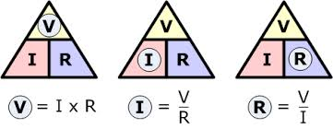
Lab 3 – Series Resistors Current and Voltage, Observations
The measured resistance values were all within tolerance of the nominal values.
The Measured, calculated and simulated values all had very similar magnitudes.
Using Ohm’s Law it was possible to make all of the calculations necessary.
Ohm’s Law:

Slide 25
Lab 3 – Series Resistors Current and Voltage, Conclusion
The Calculated, simulated and measured results all agreed with one another and demonstrated that each was a viable option to find the total current and voltage drops in a series of resistors.

Slide 26
LAB 4:Black Box Design (Series)
Josiah Abel
Date: 2/12/2015
Lab Partners: Dakota Johnson and Cody Fletcher
Lab Bench # 6
EECT 111

Slide 27
Lab 4 – Black Box Design (Series)
OBJECTIVE: To create a series circuit that meets the design specifications for Voltage and Current in the circuit.
-MATERIALS-
Digital Multimeter, GW INSTEK GDM-8245, Serial #: CL860332
NI ELVIS II+, breadboard, Serial #: 1677D1E
3 resistors, (100 Ω, 470 Ω, and 330 Ω)
Multisim 13.0 Computer program
Various Jumper Wires

Slide 28
Lab 4 – Black Box Design (Series), Procedure
A Circuit with three resistors in series has a Voltage of 9V and a total current of 10.00mA. Using the equation V/I = R, the total resistance needed to fulfill these specifications was determined. Three resistors were selected. When added together (Calculating RT of series circuit) these resistors were equivalent to the total resistance discovered earlier.

Slide 29
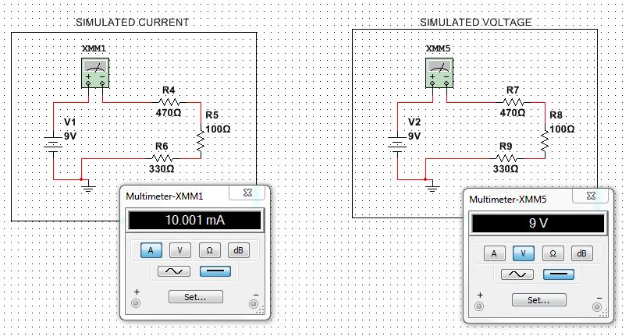
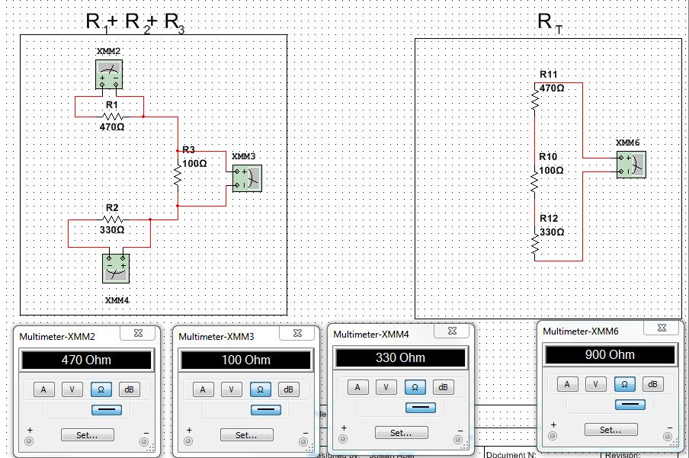
Lab 4 – Black Box Design (Series), Simulation

Slide 30
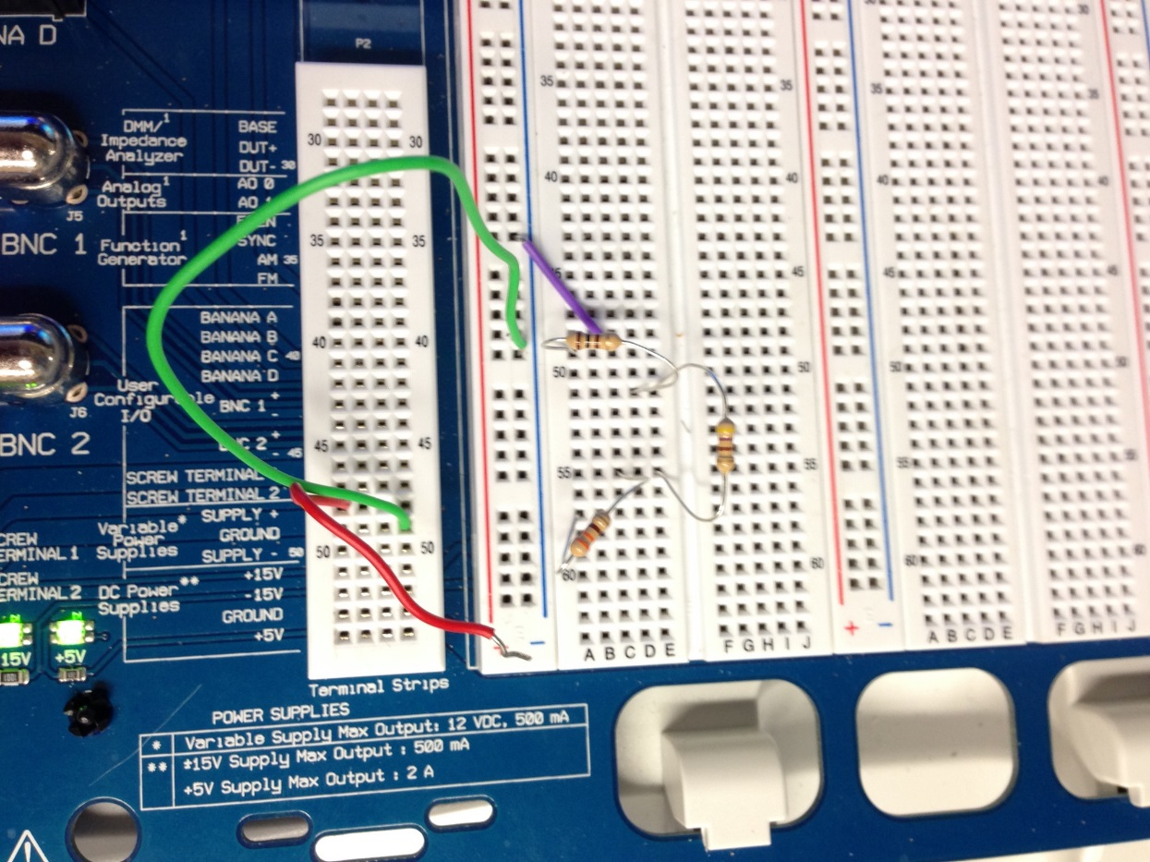
Lab 4 – Black Box Design (Series), Setup/Pictures
100 Ω
470 Ω
330 Ω

Slide 31


Lab 4 DATA:
$$V=I ∗R_{T}$$
$$R_{T}=R1+R2+R3$$

Slide 32
Lab 4 – Black Box Design (Series), Observations
Measuring Current and voltage in a series circuit is easiest to accomplish if the circuit is both powered and grounded.
The Current throughout the entire circuit is the same. If the current were to be measured anywhere in the circuit the magnitude would be identical to any other location.
Using Ohm’s Law makes finding an unknown resistance quite easy if both the voltage and current are known.

Slide 33
Lab 4 – Black Box Design (Series), Conclusion
The measured current and total resistance for the 100 Ω, 470 Ω, and 330 Ω series circuit were equivalent to the required design specifications. (9V, 10.00mA, 900 Ω)

Slide 34
LAB 5:Black Box Design (Parallel)
Josiah Abel
Date: 2/19/2015
Lab Partners: Dakota Johnson and Cody Fletcher
Lab Bench # 6
EECT 111

Slide 35
Lab 5 – Black Box Design (Parallel)
OBJECTIVE: To create a Parallel circuit using two resistors that meets the design specifications for Voltage and Current in the circuit. Then to create a Parallel circuit using three resistors that meets the design specifications for Voltage and Current in the circuit.
-MATERIALS-
Digital Multimeter, GW INSTEK GDM-8245, Serial #: CL860332
NI ELVIS II+, breadboard, Serial #: 1677D1E
2 resistors, (3.3 KΩ, 4.7 KΩ)
3 resistors, (4.7 KΩ, 5.6 KΩ, 8.2 KΩ)
Multisim 13.0 Computer program
Assorted Jumper Wires

Slide 36
Lab 5 – Black Box Design (Parallel), Procedure
A Circuit with two resistors in parallel has a Voltage of 9V and a total current of 4.642mA. Using the equation V/I = R, the total resistance needed to fulfill these specifications was determined. Two resistors were selected to create the proper parallel resistance (3.3 KΩ and 4.7 KΩ). The circuit was built in the lab and measurements were taken. Next a Circuit was simulated with three resistors in parallel has a Voltage of 9V and a total current of 4.642mA. Three resistors were selected to create the proper parallel resistance (4.7 KΩ, 5.6 KΩ, 8.2 KΩ). The circuit was built in the lab and measurements were taken.

Slide 37
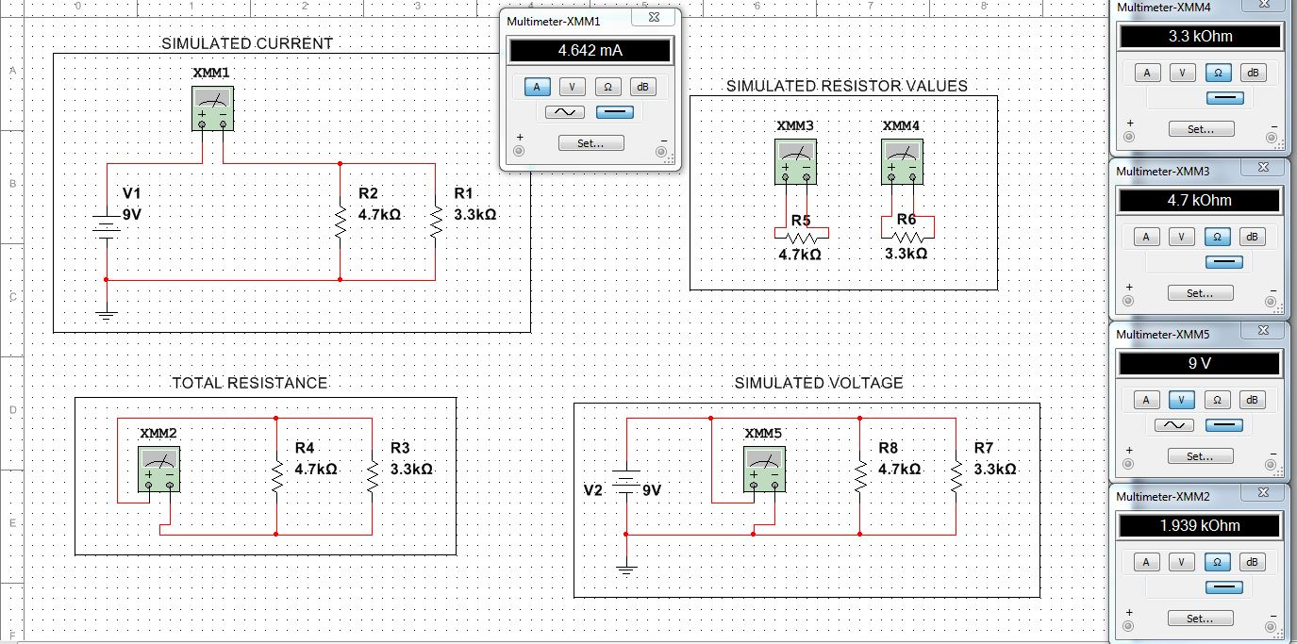
SIMULATION: 2 resistors

Slide 38
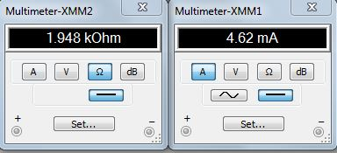
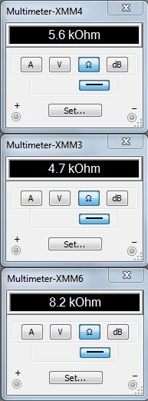
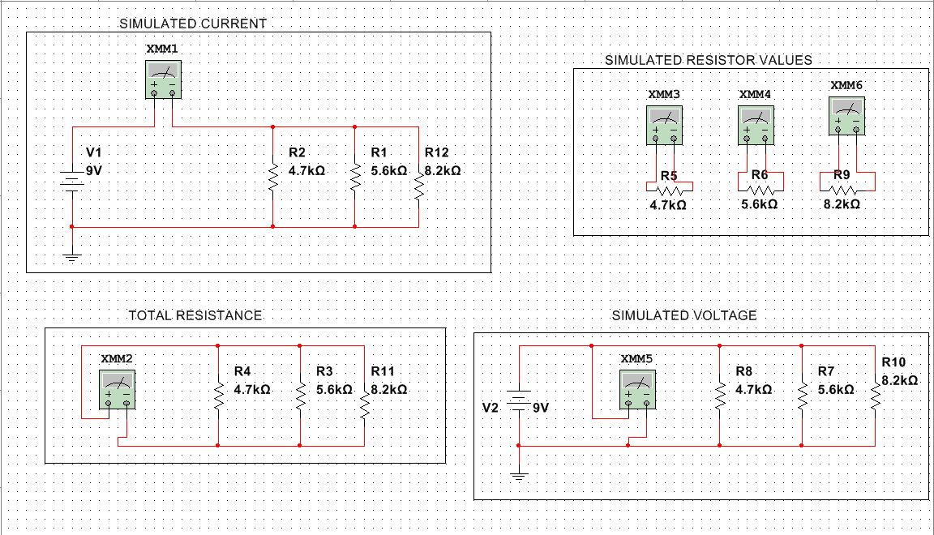
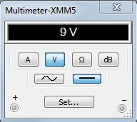
SIMULATION: 3 resistors

Slide 39
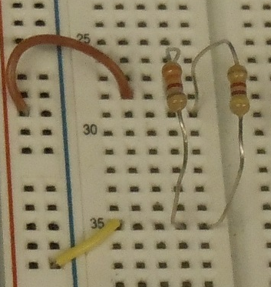
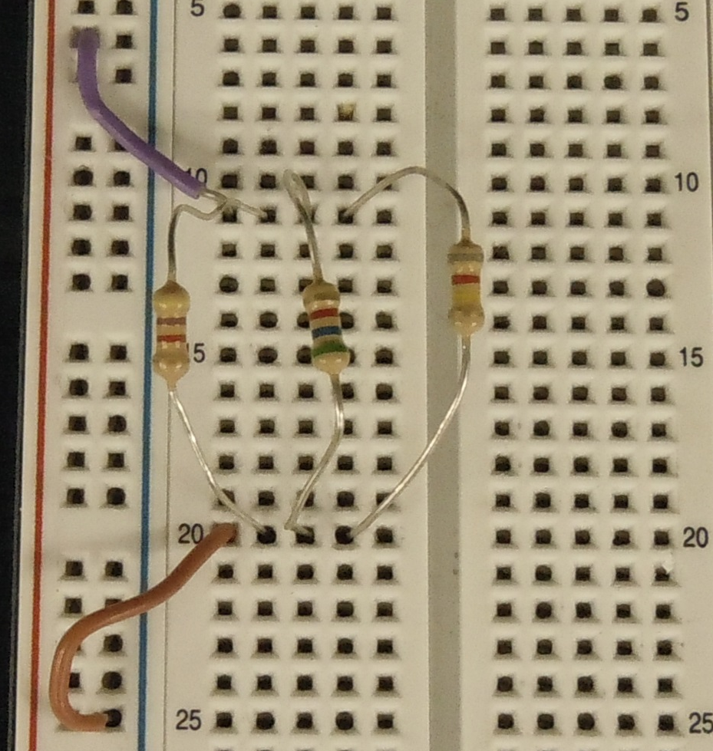
Lab 5 – Black Box Design (Parallel), Setup
2 Resistors in Parallel
3 Resistors in
Parallel
3.3 KΩ
4.7 KΩ
4.7 KΩ
5.6 KΩ
8.2 KΩ

Slide 40
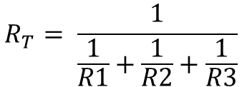
Lab 5 DATA:
$$R_{T}= \frac{1}{\frac{1}{R1}+\frac{1}{R2}+\frac{1}{R3}}$$

Slide 41


Lab 5 – Black Box Design (Parallel), Observations
Measuring Current and voltage in a series circuit is easiest to accomplish if the circuit is both powered and grounded.
The Current across each branch was different however the voltage across each was identical.
Using Ohm’s Law makes finding an unknown resistance quite easy if both the voltage and current are known.
$$R_{T}= \frac{1}{\frac{1}{R1}+\frac{1}{R2}+\frac{1}{R12}}$$
$$I_{T}= \frac{V}{R_{T}}$$

Slide 42
Lab 5 – Black Box Design (Parallel), Conclusion
The measured current and total resistance for the three circuit were very similar to the required design specifications. (9V, 4.642mA, 1957 Ω)

Slide 43
LAB 6: 4 Resistor Parallel Circuit
Josiah Abel
Date: 2/26/2015
Lab Partners: Dakota Johnson and Cody Fletcher
Lab Bench # 6
EECT 111

Slide 44

ERROR
(NO DATA FOUND)
[NULL]
[NULL]

Slide 45
LAB 7: 4 Resistor Parallel Circuit
Josiah Abel
Date: 2/26/2015
Lab Partners: Dakota Johnson and Cody Fletcher
Lab Bench # 6
EECT 111

Slide 46
Lab 7 – 4 Resistor Parallel Circuit
OBJECTIVE: To create a four branch Parallel circuit using four resistors. Measure all of the resistor values, the total current and all of the branch currents.
-MATERIALS-
Digital Multimeter, GW INSTEK GDM-8245, Serial #: CL860332
NI ELVIS II+, breadboard, Serial #: 1677D1E
4 resistors, (4.7 KΩ, 4.7 KΩ, 3.3 KΩ, 2.2 KΩ )
Multisim 13.0 Computer program
Assorted Jumper Wires

Slide 47
Lab 7 – 4 Resistor Parallel Circuit, Procedure
4 resistors were measured with a multimeter then placed in a parallel circuit on an Elvis board. The total resistance was then measured. The circuit was connected to a 9V source and the total current and branch currents were measured with a multimeter set as an ammeter.

Slide 48
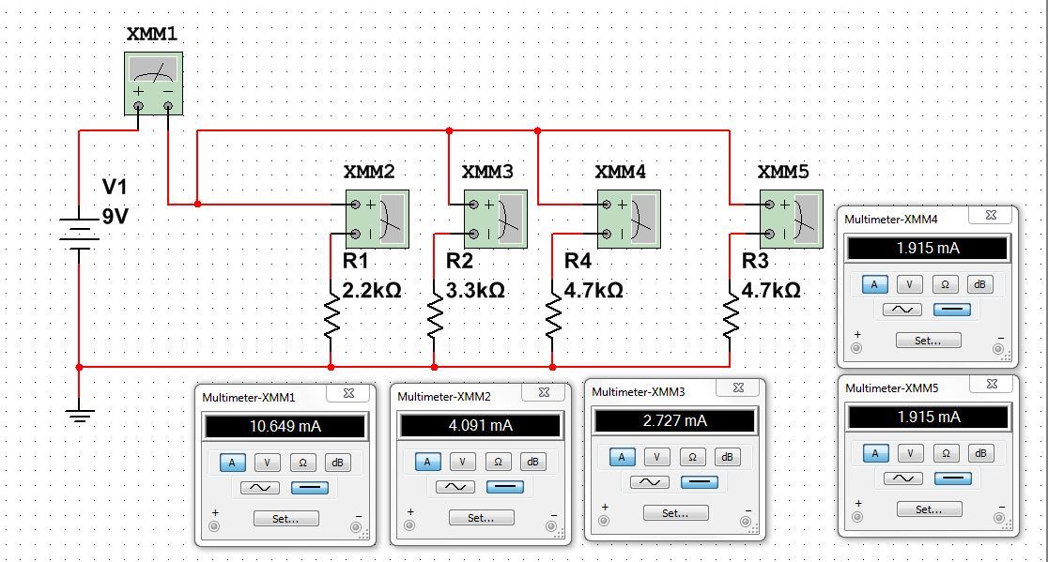
Lab 7 – 4 Resistor Parallel Circuit, Simulation

Slide 49
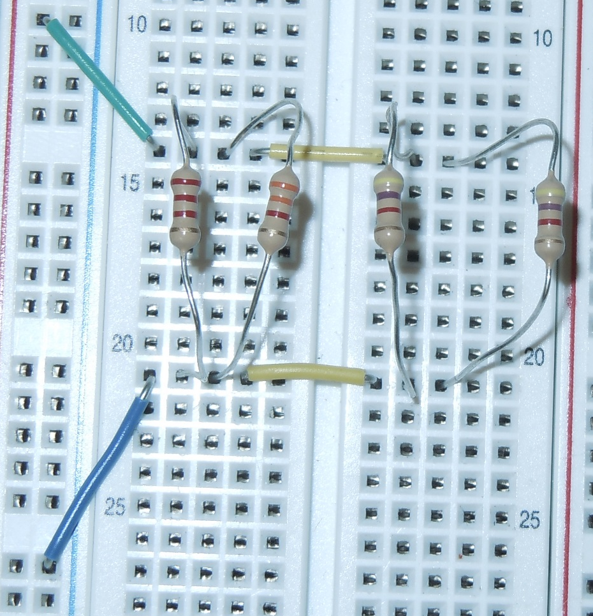
Lab 7 – 4 Resistor Parallel Circuit, Setup
2.2 KΩ
3.3 KΩ
4.7 KΩ

Slide 50


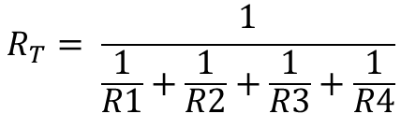



Lab 7 DATA:
$$R_{T}= \frac{1}{\frac{1}{R1}+\frac{1}{R2}+\frac{1}{R3}+\frac{1}{R4}}$$
LAB 7
 |  | Design | Measured | Calculated | Simulated
V | V1 | 9 | 9.003 |  | 9
k Ω | R 1 | 2.2 | 2.151 |  | 2.2
k Ω | R 2 | 3.3 | 3.255 |  | 3.3
k Ω | R 3 | 4.7 | 4.623 |  | 4.7
k Ω | R 4 | 4.7 | 4.634 |  | 4.7
k Ω | RT |  | 0.8299 | 0.8304 | .845
mA | I 1 |  | 3.992 | 4.1855 | 4.091
mA | I 2 |  | 2.679 | 2.7659 | 2.727
mA | I 3 |  | 1.845 | 1.9474 | 1.915
mA | I 4 |  | 1.8996 | 1.9428 | 1.915
mA | IT |  | 10.667 | 10.8483 | 10.649
$$\frac{V}{R_{T}}=I_{T}$$
$$I_{1}=\frac{V}{R_{1}}$$
$$I_{2}=\frac{V}{R_{2}}$$
$$I_{3}=\frac{V}{R_{3}}$$
$$I_{4}=\frac{V}{R_{4}}$$

Slide 51
Lab 7 – 4 Resistor Parallel Circuit, Observations
Current is not constant in a parallel resistor circuit and differs depending on the size of the resistor on the branch.
In the Parallel Circuit, the value for the total resistance of the parallel resistors is always less than the smallest resistor in that parallel circuit.
In a Parallel Circuit the voltage across each branch is the same.

Slide 52
Lab 7 – 4 Resistor Parallel Circuit, Conclusion
The total current and branch currents were successfully measured.

Slide 53
LAB 8: Black Box 3 Design
Josiah Abel
Date: 2/26/2015
Lab Partners: Dakota Johnson and Cody Fletcher
Lab Bench # 6
EECT 111

Slide 54
Lab 8 – Black Box 3 Design
OBJECTIVE: To Build a Series Parallel resistor circuit in which the source voltage is 9V and there are five resistors three of which are in parallel with each other. The voltage across three parallel resistors should be approximately 1.3V.
-MATERIALS-
Digital Multimeter, GW INSTEK GDM-8245, Serial #: CL860332
Variable Power Supply, RSR-369987, Serial #: HY802D
Solderless Breadboard
4 resistors, ( 4.7 KΩ, 4.7 KΩ, 4.7 KΩ, 4.7 KΩ)
1 10 KΩ Variable Resistor (set to 4.7 KΩ)
Multisim 13.0 Computer program
Assorted Jumper Wires

Slide 55
Lab 8 – Black Box 3 Design, Procedure
Calculations were done to determine the three Resistors in parallel. The 5 resistors were measured with a multimeter then placed in a series/parallel circuit on an Elvis board. a known input voltage was presented and the resistor values had to be found that would equal the difference between the two nodal voltages. In order to do this the total current had to be found and once that was found the total resistance could be found using Ohm’s law. The two known resistor values were subtracted from the total to get the total of the unknown resistors. Once the total unknown resistor value was found the number was divided by 3 to find the values of the three resistors in a parallel circuit. The circuit was then built and the nodal voltages were tested to see if the circuit was correct. Once the circuit was found to be correct a 10kohm potentiometer replaced with one of the known resistors and then the nodal voltages were adjusted to be the exact numbers desired

Slide 56
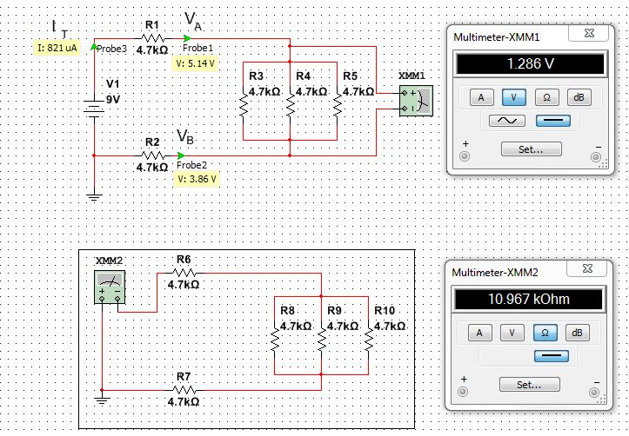
Lab 8 – Black Box 3 Design, Simulation

Slide 57
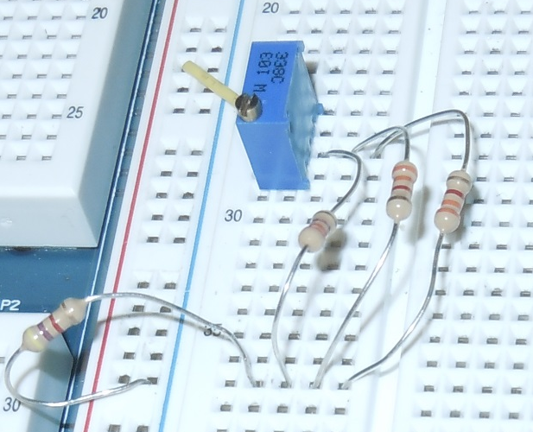
Lab 8 – Black Box 3 Design, Setup
4.7 KΩ POT
4.7 KΩ

Slide 58






Lab 8 DATA:
LAB 8
 |  | Design | Measured | Adj | Calculated | Simulated
k Ω | R 1 | 4.7 | 4.702 | 4.64 | 4.7 | 4.7
k Ω | R 2 | 4.7 | 4.62 | 4.62 | 4.7 | 4.7
k Ω | R 3 | 4.7 | 4.732 | 4.732 | 4.7 | 4.7
k Ω | R 4 | 4.7 | 4.631 | 4.631 | 4.7 | 4.7
k Ω | R 5 | 4.7 | 4.6 | 4.6 | 4.7 | 4.7
k Ω | R T | 10.967 | 10.86867 | 10.80667 | 10.966667 | 10.96667
k Ω | R BlackBox | 1.5667 | 1.553
k Ω | R 1 Adj | 0.2736 | 4.64
mA | IT | 0.8207 |  | 0.837446 | 0.8206687
V | V 1 | 9 | 9.05 | 9.05 | 9 | 9
V | VA | 5.14 | 5.169 |  | 5.1428571 | 5.14
V | V B | 3.86 | 3.8648 |  | 3.8571429 | 3.86
V | V A-V B | 1.286 | 1.3042 |  | 1.2857143 | 1.286
V | (V A-V B) Adj |  | 1.2861 | 1.303
$$\frac{V}{R_{1}}=I_{T}$$
$$Voltage drop (R1)= I_{T}∗R1$$
$$Voltage drop (R5)= I_{T}∗R5$$
$$VA=V1−Voltage drop (R1)$$
$$VB=Voltage drop (R5)$$

Slide 59
Lab 8 – Black Box 3 Design, Observations
Current is not constant in a parallel resistor circuit and differs depending on the size of the resistor on the branch. However the current entering the Parallel section and leaving it has the same magnitude.
Having all of the resistor the same value in the parallel section of the circuit made the Calculation for finding the individual resistors easier.

Slide 60
Lab 8 – Black Box 3 Design, Conclusion
By using a variation of Ohm’s Law it was possible to create the circuit which matched the required specifications.

Slide 61
LAB 9:Series/Parallel Resistors
Josiah Abel
Date: 3/26/2015
Lab Partners: Dakota Johnson and Cody Fletcher
Lab Bench # 6
EECT 111

Slide 62
Lab 9 – Series/Parallel Resistors
OBJECTIVE: To experiment with a combined series and parallel resistor circuit and verify that the simulation, calculations and measured results agree
-MATERIALS-
Digital Multimeter, GW INSTEK GDM-8245, Serial #: CL860332
Variable Power Supply, RSR-369987, Serial #: HY802D
Solderless Breadboard
8 resistors, ( 2x 470 Ω, 4.7 KΩ, 10 KΩ, 3.3 KΩ, 2.2 KΩ, 2x 1 KΩ)
1 10 KΩ Variable Resistor (set to 4.7 KΩ)
Multisim 13.0 Computer program
Assorted Jumper Wires

Slide 63
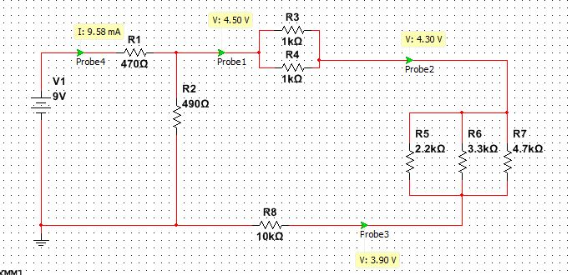
Lab 9 – Series/Parallel Resistors, Procedure
The values of each of the resistors was measured using the multimeter. The resistors were then put into a circuit designed like in the figure below. The resistances of the parallel components of the circuit R34,R567, R345678, and R2345678 were then measured. The total resistance of the circuit was then measured. The circuit was then connected to a 9V source and the total current of the circuit was measured along with the nodal voltages VA,VB, and VC. The resistor R2 was then replaced with a potentiometer and was adjusted so that the nodal voltage was exactly 4.5V.

Slide 64
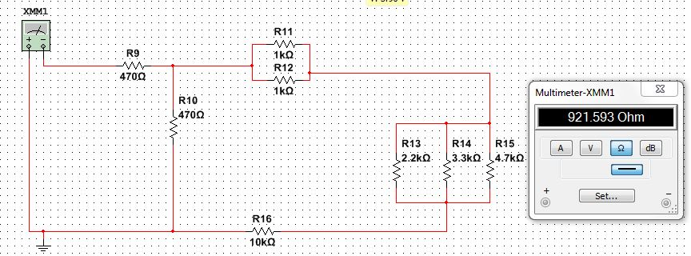
Lab 9 – Series/Parallel Resistors, Simulation
Total Resistance

Slide 65
Lab 9 – Series/Parallel Resistors, Simulation
IT
VA
VB
VC

Slide 66
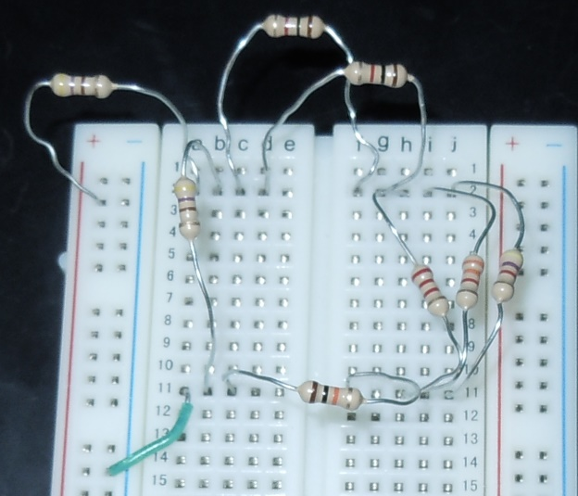
Lab 9 – Series/Parallel Resistors, Setup
1 KΩ
470 Ω
2.2 KΩ, 3.3 KΩ, 4.7 KΩ
10 KΩ

Slide 67
Lab 9 DATA:
Resistor | simulated in Ω | Measured in Ω | Calculated in Ω
R1 | 470 | 463.64 | 470
R2 | 470 | 455.5 | 470
R3 | 1000 | 981 | 1000
R4 | 1000 | 983.5 | 1000
R5 | 2200 | 2163 | 2200
R6 | 3300 | 3248 | 3300
R7 | 4700 | 4643 | 4700
R8 | 10000 | 9575 | 10000
R34 |  |  | 500.00
R567 |  |  | 1030.56
R345678 |  |  | 11530.56
R2345678 |  |  | 451.59
RT |  |  | 921.59
 |  | simulated in Ω | Measured | Calculated
V1 | V |  | 9.002 | 9
IT | mA |  | 9.856 | 9.768
VA | V |  | 4.36 | 4.473
VB | V |  | 4.172 | 4.279
VC | V |  | 3.778 | 3.879
I345678 | mA |  |  | 0.38794481
Vadj= | V | 4.5
Vs= | V | 9
Steps | Calculation
V*(R99/(R1+R99)
R99=4.5R2
R99=R2llR
(R99/(A3+R99))*9=4.5 | R99 | = | 470
470=R2llE13
470=1/((1/R2)+(1/E13)
470=E13R2/(E13+R2)
470*(E13+R2)=E13R2
470*E13+470R2=E13R2 | 5419365.449 | + | 470 | xR2 | = | 11530.56 | xR2
 |  |  | 5419365.449 | = |  | 11060.56 | xR2
 | R2 ADJ | = | 489.9718554

Slide 68

Lab 9 – Series/Parallel Resistors, Observations
Once the equivalent resistance is found for a parallel resistors the equivalent resistance can then be added with other resistors in either series or parallel.
Using a voltage divider the adjusted resistance was easier to achieve. The divider was set at the first resistor (470 ohms) [R1] and used the sum of the two large parallel branches (R2).
$$4.5V=\left(\frac{R_{1}}{R_{1}+R_{2}}\right)∗V_{1}$$

Slide 69

Lab 9 – Series/Parallel Resistors, Conclusion
The simulation results and calculations Matched the Data gathered in the lab.

Slide 70
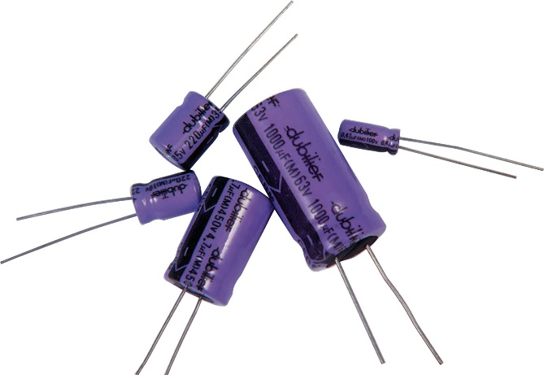
LAB 10: Series/Parallel Capacitors
Josiah Abel
Date: 4/2/2015
Lab Partners: Dakota Johnson and Cody Fletcher
Lab Bench # 6
EECT 111

Slide 71
Lab 10 – Series/Parallel Capacitors
OBJECTIVE: To experiment with capacitors in series and parallel capacitors.
-MATERIALS-
Digital Multimeter, GW INSTEK GDM-8245, Serial #: CL860332
LCR Meter, GW INSTEK, LLR METER LCR-819, Serial #: E120998
Variable Power Supply, RSR 369987, Serial #: HY802D
Solderless Breadboard
3 Capacitors ( 10 µF, 22 µF, 47 µF)
Multisim 13.0 Computer program

Slide 72
Lab 10 – Series/Parallel Capacitors, Procedure
The capacitance of each of the capacitors were measured individually with the LCR meter. The capacitors were then put into a series circuit and the total capacitance was measured. Finally the capacitors were put into a parallel circuit and the total capacitance was measured.

Slide 73
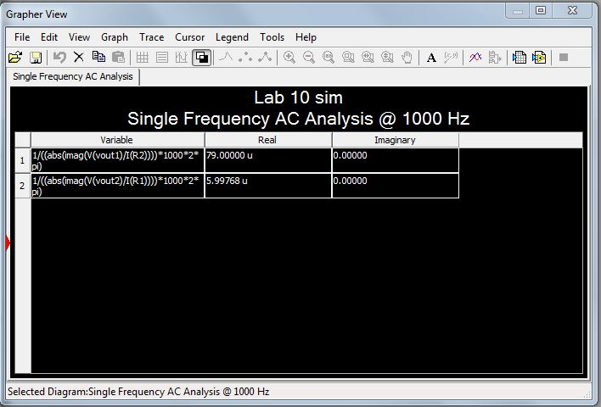
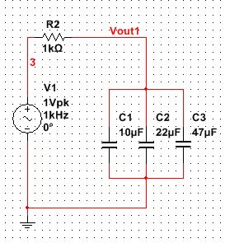
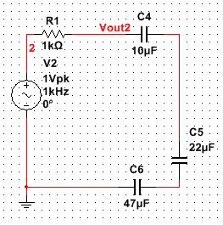
Lab 10 – Series/Parallel Capacitors, Simulation
Parallel
Series

Slide 74
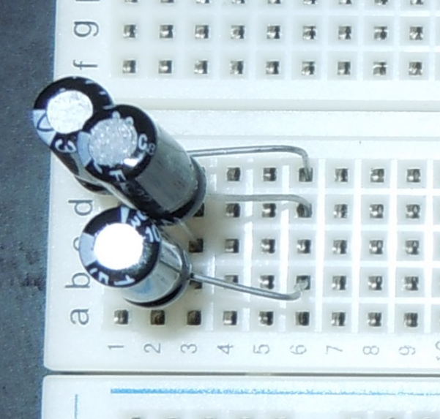
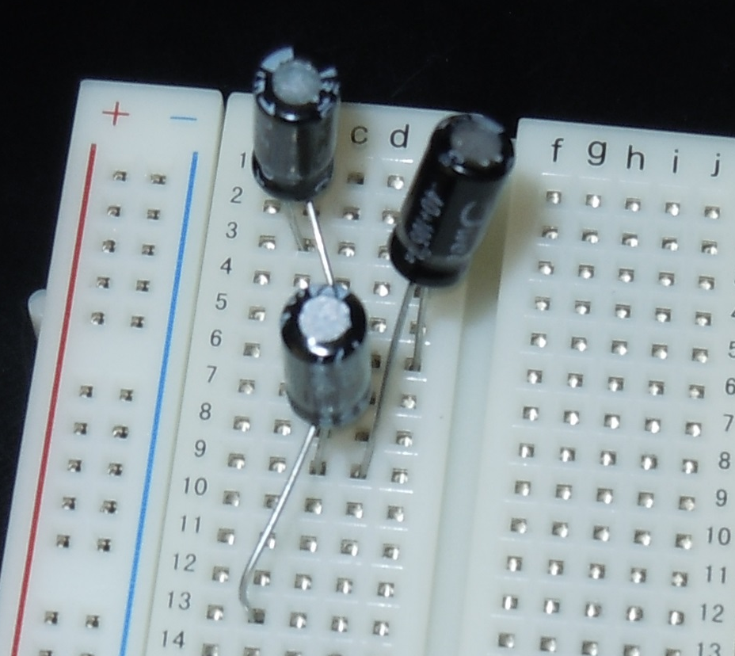
Lab 10 – Series/Parallel Capacitors, Setup
Parallel
Series
10 µF
22 µF
47 µF

Slide 75

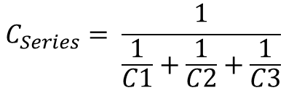
Lab 10 DATA:
Series
 | Calculated | Measured | Simulated
 | μF | μF | μF
C1 | 10 | 9.16 | 10
C2 | 22 | 19.51 | 22
C3 | 47 | 38.8 | 47
CT | 5.9976798 | 5.37 | 5.99768
Parallel
 | Calculated | Measured | Simulated
 | μF | μF | μF
C1 | 10 | 9.16 | 10
C2 | 22 | 19.51 | 22
C3 | 47 | 38.8 | 47
CT | 79 | 67.501 | 79
$$C_{Series}= \frac{1}{\frac{1}{C1}+\frac{1}{C2}+\frac{1}{C3}}$$
$$C_{Parallel}=C1+C2+C3$$

Slide 76
Lab 10 – Series/Parallel Capacitors, Observations
When capacitors are put in series their total capacitance is calculated like resistors in parallel.
When capacitors are put in parallel their total capacitance is calculated like resistors in series.
The 47 micro Henry capacitor was quiet a bit lower than the expected value.
A reason for this might be that the capacitor is starting to go bad.

Slide 77
Lab 10 – Series/Parallel Capacitors, Conclusion
The Measured values were within tolerance of the Calculated and simulated results. This confirmed that the method for measuring capacitance was accurate.

Slide 78
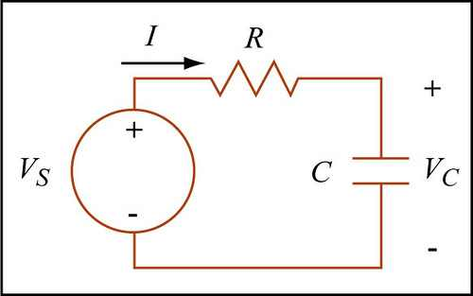
LAB 11: RC Lab
Josiah Abel
Date: 4/9/2015
Lab Partners: Dakota Johnson and Cody Fletcher
Lab Bench # 6
EECT 111

Slide 79
Lab 11 – RC Lab
OBJECTIVE: To experiment with a resistor and a capacitor in a series circuit with each other.
-MATERIALS-
Digital Multimeter, GW INSTEK GDM-8245, Serial #: CL860332
LCR Meter, GW INSTEK, LLR METER LCR-819, Serial #: E120998
Oscilloscope, Tektronix TDS 220, Serial #: B083266
Function Generator, GW INSTEK, GFG-8210, Serial #: A173775
3 Capacitors, (1 µF, 2.2 µF, 0.47 µF)
1 Resistor, (1 KΩ)
Multisim 13.0 Computer program
Assorted Jumper Wires

Slide 80
Lab 11 – RC Lab, Procedure
The resistor value was measured using the multimeter and the capacitor values were measured using the LCR meter. The resistor and capacitor were put in a circuit like in the picture below with the AC power source being the function generator. The oscilloscope was hooked up to the function generator and the function generator’s amplitude was dialed in so that it was 1V peak to peak. The other lead of the oscilloscope was hooked up to the circuit between the resistor and capacitor. The voltage at the point between the resistor and capacitor was then measured at a range of frequencies. This process was done for all three capacitors.

Slide 81
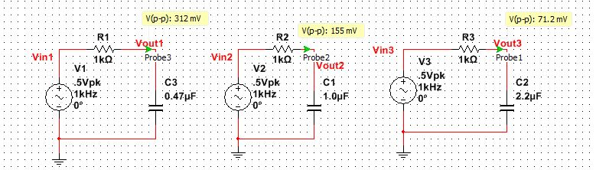
Lab 11 – RC Lab, Simulation @ 1K HZ frequency

Slide 82
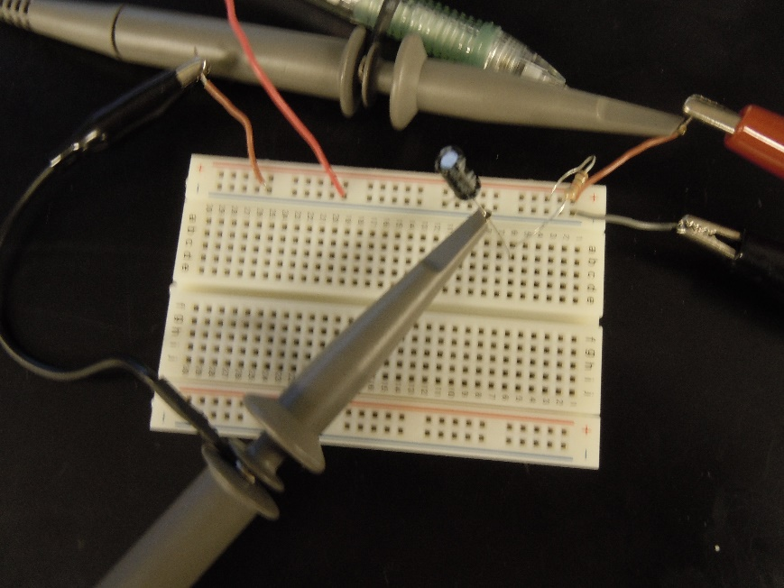
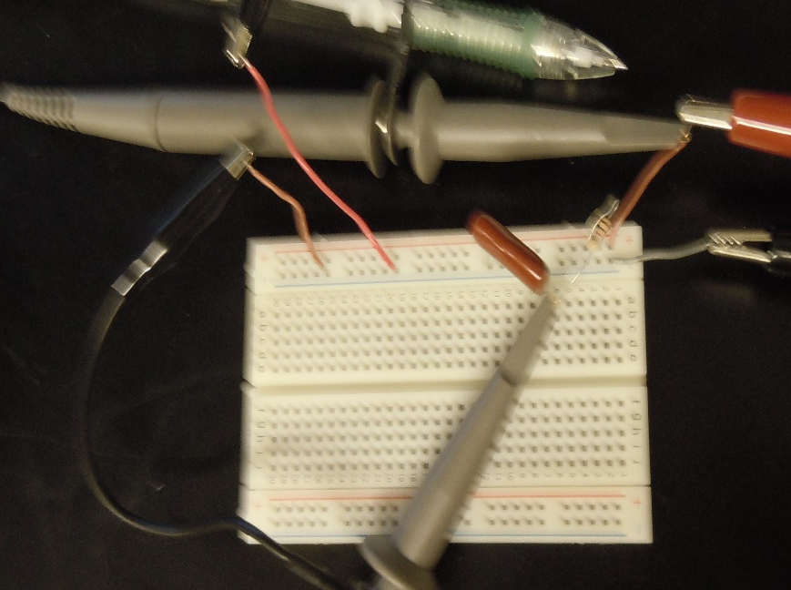
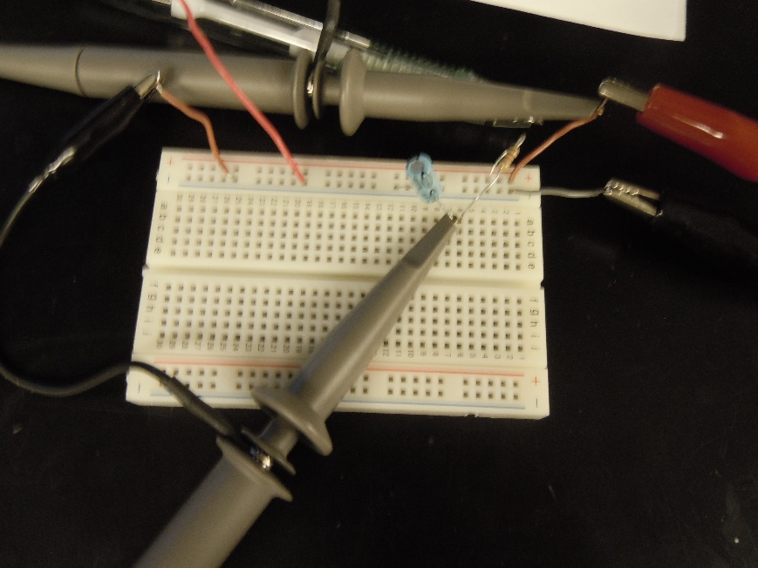
Lab 11 – RC Lab, Setup
1 KΩ
0.47 µF
1.0 µF
2.2 µF

Slide 83
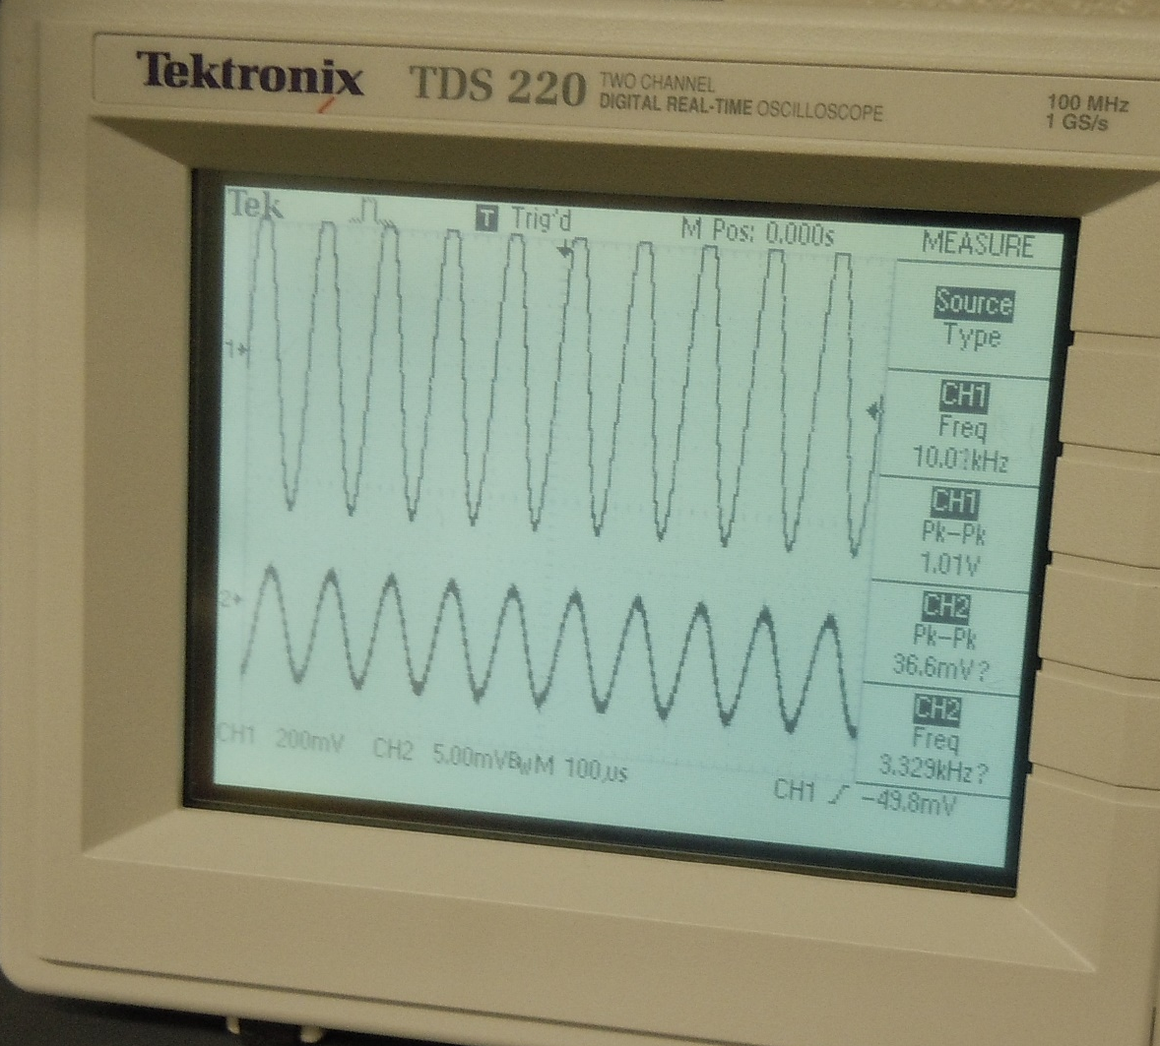
Lab 11 – RC Lab, Setup
Frequency (f)
Capacitor Voltage

Slide 84



Lab 11 DATA:
$$Z=\sqrt{R^{2}+X_{c}^{2}}$$
$$X_{c}=\frac{1}{2∗π∗f∗C}$$
$$V_{C}=I_{C}∗Z$$

Slide 85
Lab 11 DATA GRAPH:

Slide 86



Lab 11 – RC Lab, Observations
The output voltage did not observe a linear behavior.
Even though the 1.0 µF Capacitor was a different style it performed in the same fashion as the other two electrolytic Capacitors.
The equations on the Lab Data section still reflect the basic principle of ohm’s law. More calculations are required to reach the needed voltage however.
$$Z=\sqrt{R^{2}+X_{c}^{2}}$$
$$X_{c}=\frac{1}{2∗π∗f∗C}$$
$$V_{C}=I_{C}∗Z$$

Slide 87
Lab 11 – RC Lab, Conclusions
The Measurements taken in the lab matched the expected results from the simulation.
The Calculations also demonstrated that the measurements were accurate.

Slide 88
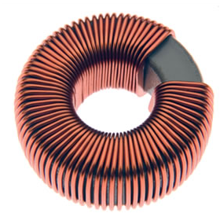
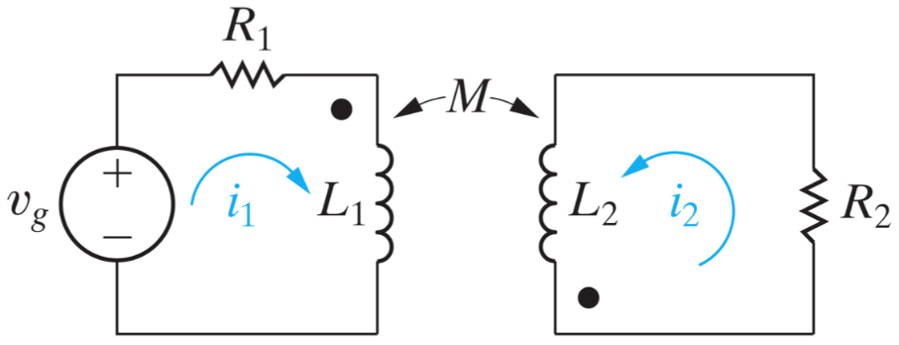
LAB 12: Series/Parallel Inductors
Josiah Abel
Date: 2/26/2015
Lab Partners: Dakota Johnson and Cody Fletcher
Lab Bench # 6
EECT 111

Slide 89
Lab 12 – Series/Parallel Inductors
OBJECTIVE: To Experiment with series and parallel combinations of Inductors.
-MATERIALS-
LCR Meter, GW INSTEK, LLR METER LCR-819, Serial #: E120998
Solderless Breadboard
3 Inductors, (1 mH, 2.2 mH, 4.7 mH)
Multisim 13.0 Computer program

Slide 90
Lab 12 – Series/Parallel Inductors, Procedure
The individual inductors were measured with the LCR meter.
The inductors were then put in a series circuit and the total inductance was measured with the LCR meter.
The inductors were put in a parallel circuit and the total inductance was measured with the LCR meter.

Slide 91
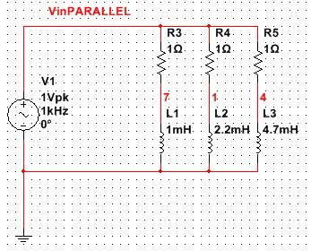
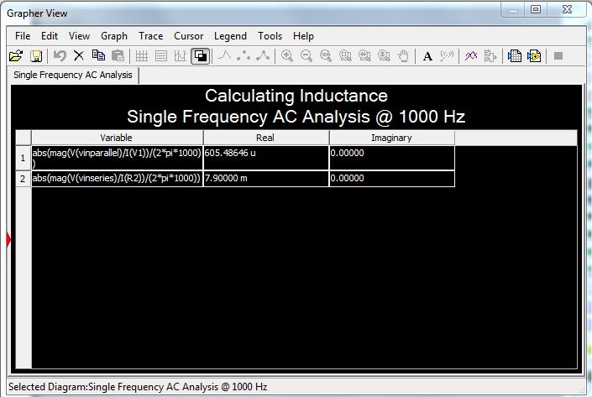
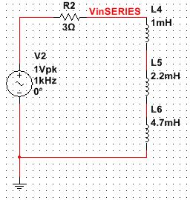
Lab 12 – Series/Parallel Inductors, Simulation (Resistors were required for the simulation to function properly)

Slide 92
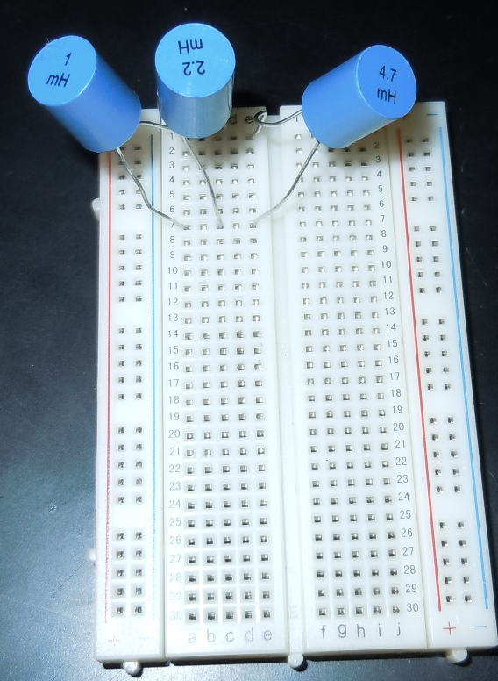
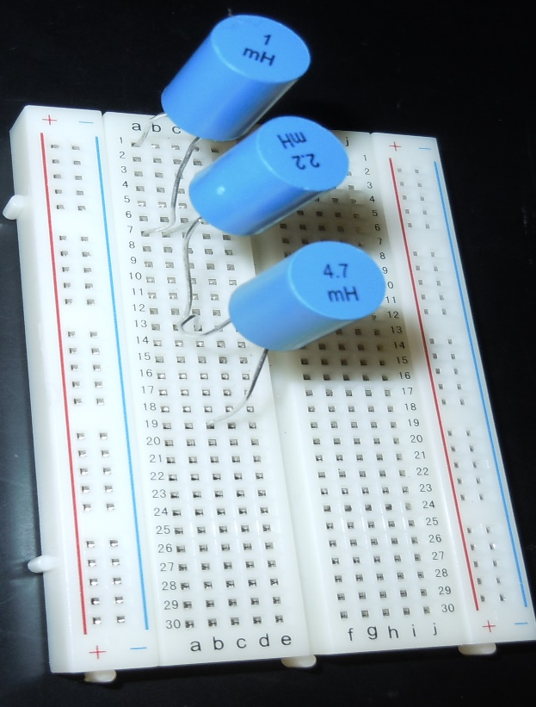
Lab 12 – Series/Parallel Inductors, Setup
1 mH
2.2 mH
4.7 mH

Slide 93
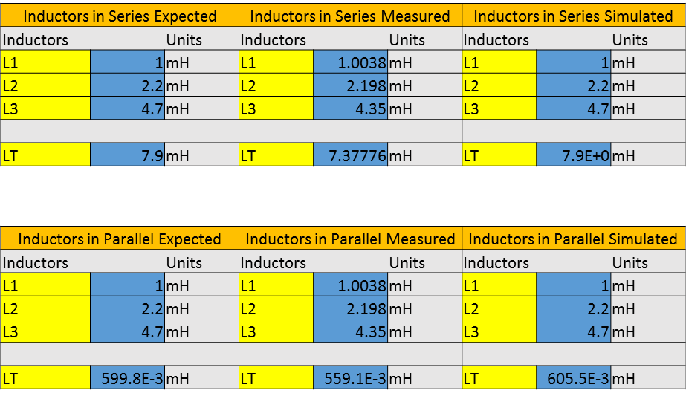
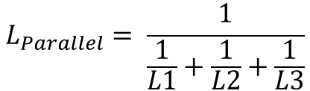

Lab 12 DATA:
$$L_{Parallel}= \frac{1}{\frac{1}{L1}+\frac{1}{L2}+\frac{1}{L3}}$$
$$L_{Series}=L4+L5+L6$$

Slide 94



Lab 12 – Series/Parallel Inductors, Observations
Calculating Parallel Inductance uses the same method as parallel resistance.
Calculating Series Inductance uses the same method as Series Resistance.
Calculations for voltage across an LR circuit can be accomplished in a similar fashion to calculating the voltage across a capacitor. Ohm’s Law with additional calculations.
$$Z=\sqrt{R^{2}+X_{L}^{2}}$$
$$V_{L}=I_{L}∗Z$$
$$X_{L}=2∗π∗f∗L_{T}$$

Slide 95
Lab 12 – Black Box 3 Design, Conclusion
The Measured, Calculated and simulated values matched.

